Slide 1
House Price Prediction
Using Regression to predict house prices

Slide 2
Problem Statement
We want to make the the whole process of buying houses less cumbersome and a lot simpler.
The aim is to build a model, which would compare all the major/ minor features of a house (e.g Total plot area, Garage availability etc.) and based on the analysis try predicting a reasonable price for the house i.e. Selling price of the house.
The end product of this Project would be a reasonable selling price of a house.

Slide 3
Dataset Description
To train and test this model, we are using the Ames Housing dataset, a dataset of 79 explanatory variables which describes in detail about the various aspects of the residential homes in Ames, Iowa.
The dataset is sourced from kaggle, made available as part of on-going Kaggle competition

Slide 4
Data Cleaning and Preparation
All the columns were identified which consisted of even a single NULL/ NaN value.
Number of missing values exceed 50% of the total entries for a particular column, then we drop the column altogether.
NaN values for categorical columns, replaced by mode value of the columns.
NaN values for numerical columns, replaced by median value of the columns.

Slide 5
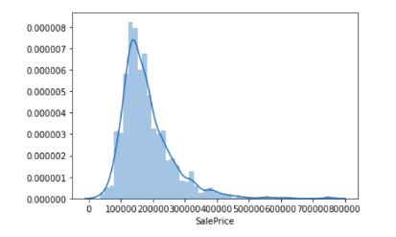
Exploratory Data Analysis
Univariate Analysis (Sale Price)
The Mean price of all the houses turns
out to be a tad under $181k.
Diversity in the house prices, indicated
by the standard deviation of around $79k
The maximum price is listed at $755k,
indicating a long right tail too.
The kurtosis value of 6.5 states that
the dataset is not normally distributed
and shows peakedness.

Slide 6
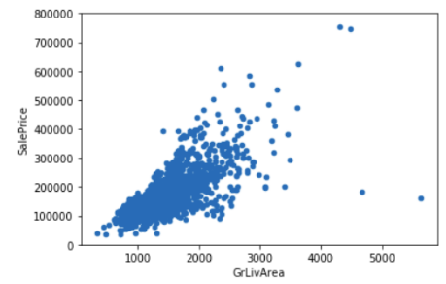
Exploratory Data Analysis
Bivariate Analysis
("GrLivArea" vs. "SalePrice")
GrLivArea ranges from 500 - 2500 sq. feet.
Both the variables shows a linear relationship
i.e. an increase in the living area is marked
by proportional increase i the selling price.
Some outliers exists, wherein the linearity doesn’t
hold and the prices observe sudden jump.

Slide 7
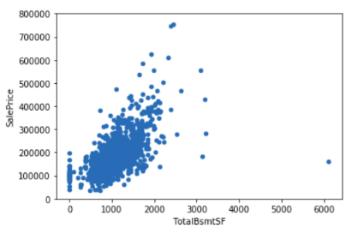
Exploratory Data Analysis
Bivariate Analysis
("TotalBsmtSF" vs. "SalePrice")
Linear relationship between the variables.
Substantial cases wherein the Selling
Price is unaffected by the basement area.
Zero area suggests data unavailability or
absence of basement in the house.

Slide 8
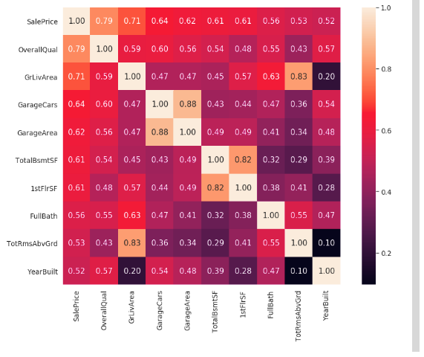
Correlation Matrix

Slide 9
Correlation Matrix
The columns "OverallQual" (0.79), "GrLivArea"(0.71) and "TotalBsmtSF"(0.61) are amongst the variables showing strong correlation with the "SalePrice".
The below sets of variables are essentially the same.
"GarageCars"(0.64) and "GarageArea"(0.62)
"TotalBsmtSF"(0.61) and "1stFlrSF"(0.61)
"TotRmsAbvGrd"(0.53) and "GrdLivArea"(0.71)
“YearBuilt" column also shows a significant correlation with the "SalePrice",

Slide 10
Hypothesis Testing
Case 1:
Null Hypthesis: No change in the average house prices for houses built before and after 1950.
Alternate Hypothesis: Average house prices change for the houses built before and after 1950.
Observations: Non significant “p value” obtained in the t-test suggests significant changes in the house prices for the stated time period.

Slide 11
Hypothesis Testing
Case 2:
Null Hypothesis: No change in the average house prices with different numbers of bathrooms.
Alternate Hypothesis: Average house prices differs as the numbers of bathrooms change.
Observations: Non significant “p value” obtained in the t-test suggests significant changes in the house prices with the change in the number of bathrooms.

Slide 12
In-depth Analysis using Machine Learning
Pre-requisites: Cleaning and EDA performed on the test dataset too. Test data set concatenated with the training dataset.
Step 1: Convert the categorical features present in the dataset into numerical features, using “one hot encoding”.
Step 2: Remove the duplicate columns from the dataset (obtained during above steps)
Step 3: Define the input variables and the target variable set.

Slide 13

In-depth Analysis using Machine Learning
Step 4: Splitting the dataset into training and testing data, using scikit-learn’s train_test_split function. The test dataset is 20% of the total available data.

Slide 14
In-depth Analysis using Machine Learning
Model Selection: The dataset with us is non-linear in nature as we had many categorical variables that were converted into numerical variables by one-hot encoding method.
Case 1: Due to the above limitations, the simple linear regression model won’t be efficient and produce good results here.

Slide 15
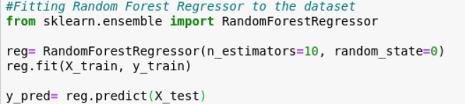
In-depth Analysis using Machine Learning
Case 2: Keeping in mind the complex nature of the dataset, we decided to proceed with the “random forest Regressor” technique.

Slide 16
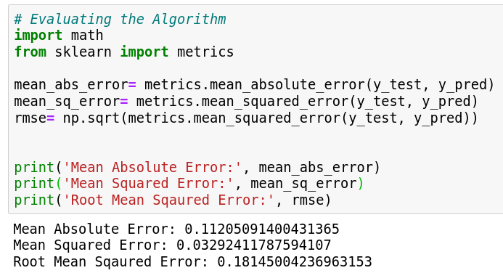
In-depth Analysis using Machine Learning
Calculating Error:

Slide 17
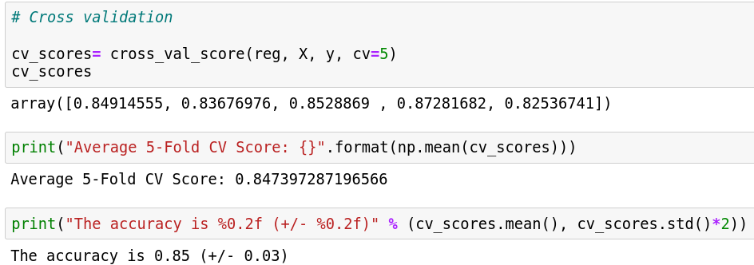
Cross Validation

Slide 18
Conclusion
As seen in the previous slides, the mean absolute error is 21220, 8.61% of the mean house prices i.e. 182899.
The RMSE is 0.181, with the estimator node value kept at 10.
The overall accuracy of the model comes around to be 85%, making it an acceptable one.

